Slide 1
Neural networks, fooling the machines, and seeing in N dimensions
Christophe Jefferies

Slide 2

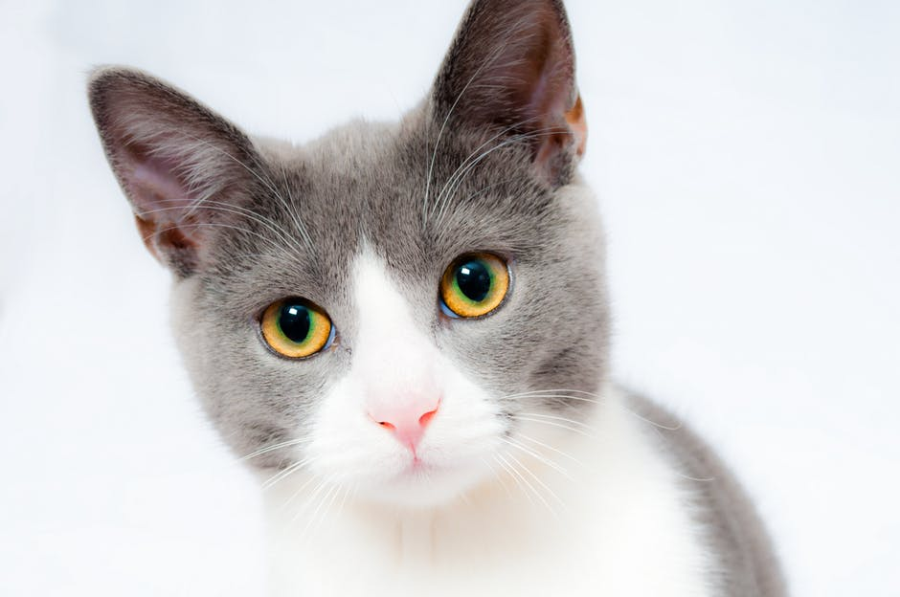
Machine learning
“My name is Christophe”
Cat

Slide 3
Decision-making graph
Shall I go to a festival?
Good weather?
1
Close by?
1
2
If ≥ 2: output yes
Cheap?
0

Slide 4
Decision-making graph
Shall I go to a festival?
Good weather?
1
1
Close by?
1
2
3
If ≥ 2: output yes
1
Cheap?
0

Slide 5

More complex decisions
What number is ?
Pixel 0
0.9
1
Pixel 1
0.3
0.5
Y
If Y ≥ B: it’s a five
-2
Pixel 99
0.6

Slide 6
More complex decisions
What number is ?
Pixel 0
0.9
w₁
If ≥ B₀: it’s a 0
w₂
Pixel 1
0.3
If ≥ B₁: it’s a 1
Pixel 99
0.6
If ≥ B₉: it’s a 9

Slide 7
More complex decisions
What number is ?
Pixel 0
0.9
w₁
-B₀
w₂
Pixel 1
0.3
-B₁
Choose largest output
Pixel 99
0.6
-B₉

Slide 8
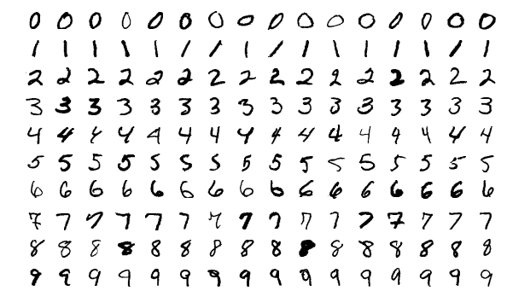
Problem
Different digits,
many shared pixels
Same digits,
very different pixels

Slide 9
Fix: layers
Pixel 0
0.9
w₁₁
w₂₁
w₂₁
w₁₂
w₂₂
w₂₂
Pixel 1
0.3
Pixel 99
0.6
Single pixels
Pixel patches
Simple shapes
Numbers
.

Slide 10
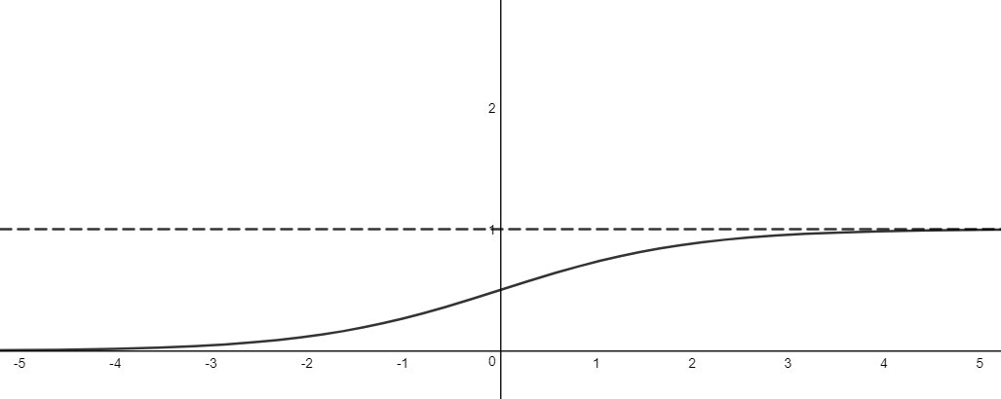
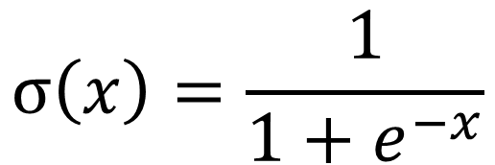
Sigmoid function
$$σ\left(x\right)=\frac{1}{1+e^{−x}}$$

Slide 11
Sigmoid function
What number is ?
Pixel 0
0.9
w₁
-B₀
_{σ}
w₂
Pixel 1
0.3
-B₁
_{σ}
Choose highest probability
Pixel 99
0.6
-B₉
_{σ}

Slide 12

‘Backpropagation’
Idea: 1) make a ‘cost’ function C measuring how wrong a prediction is
2) find $\frac{∂C}{∂w}$ and $\frac{∂C}{∂b}$ for every weight $w$ and bias $b$
3) adjust every $w$ and $b$ in the direction that decreases $C$

Slide 13

‘Backpropagation’
Pixel 0
0.9
w₁₁
-B₀
_{σ}
w₁₂
Pixel 1
0.3
-B₁
_{σ}
Pixel 99
0.6
-B₉
_{σ}
Input X Weights W Bias B Sigmoid function σ Output Y
$$Y= σ(X·W−B)$$

Slide 14

‘Backpropagation’
1st hidden layer: $Y1= σ\left(X·W1−B1\right)$
2nd hidden layer: $Y2= σ\left(Y1·W2−B2\right)=σ\left(σ(X·W1−B1) ·W2−B2\right)$
…
Final layer: $Y=$ something gross
Correct classification: $y$
Cost function: e.g. C = $||Y−y||2$ Then differentiate this…

Slide 15
Full network
Pixel 0
0.9
w₁₁
w₂₁
w₂₁
w₁₂
w₂₂
w₂₂
Pixel 1
0.3
Pixel 99
0.6
Each neuron has a bias and applies σ
We adjust weights and biases with backpropagation

Slide 16
Convolutions
1
1
1
1
2
2
1
1
1
1
2
1
1
1
1
1
1
1
1
1
1
1
3
3
3
3
1
0
1
1
1
1
Input layer
Filter
Output

Slide 17
Convolutions
1
1
1
1
2
2
1
1
2
2
1
0
3
1
1
1
1
1
1
2
1
1
1
2
1
1
1
1
1
3
2
2
1
1
1
1
1
1
1
1
1
1
1
3
3
3
3
3
3
3
3
1
2
1
2
1
1
0
1
1
1
0
1
1
1
1
1
2
2
1
Input layer
Filter
Output

Slide 18
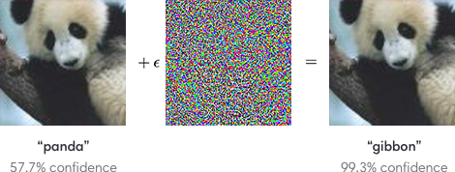
Adversarial images

Slide 19
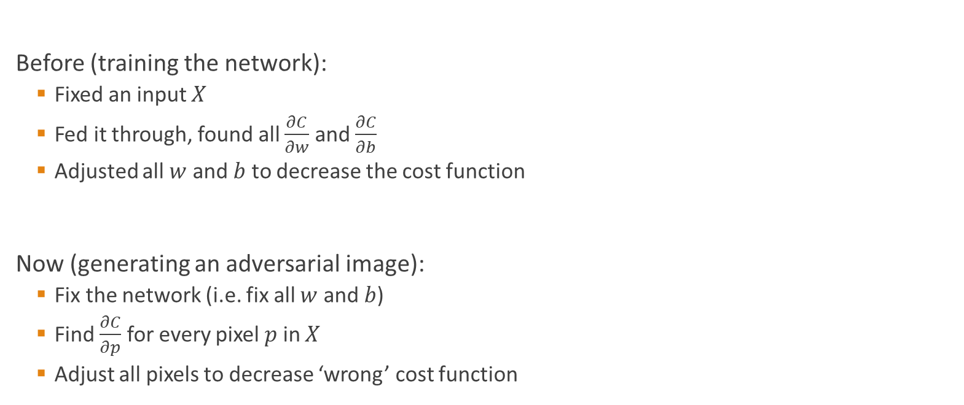
Adversarial images
Before (training the network):
Fixed an input $X$
Fed it through, found all $\frac{∂C}{∂w}$ and $\frac{∂C}{∂b}$
Adjusted all $w$ and $b$ to decrease the cost function
Now (generating an adversarial image):
Fix the network (i.e. fix all $w$ and $b$)
Find $\frac{∂C}{∂p}$ for every pixel $p$ in $X$
Adjust all pixels to decrease ‘wrong’ cost function

Slide 20
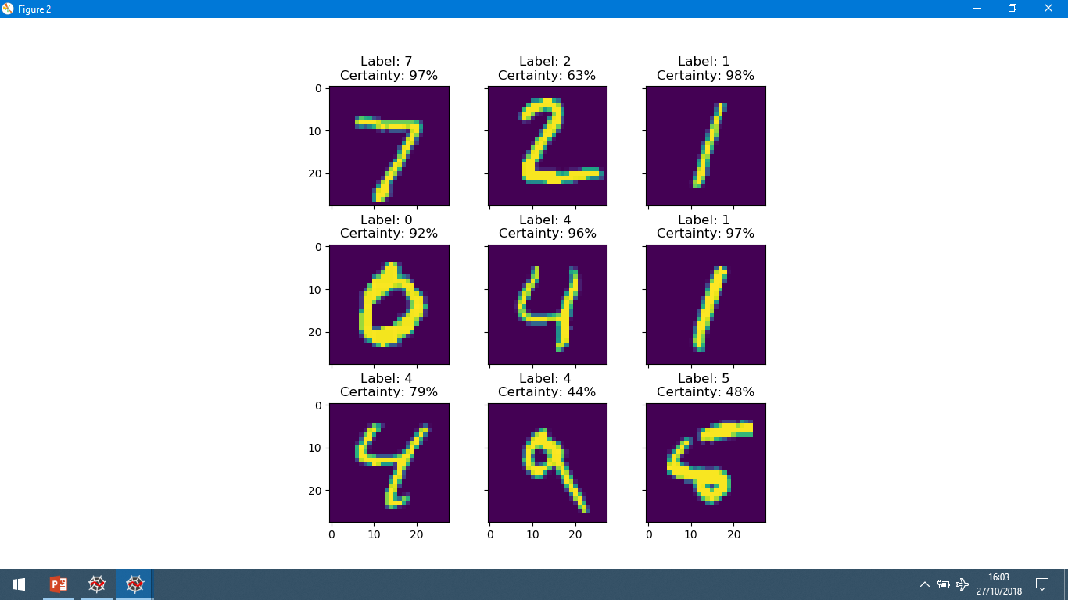
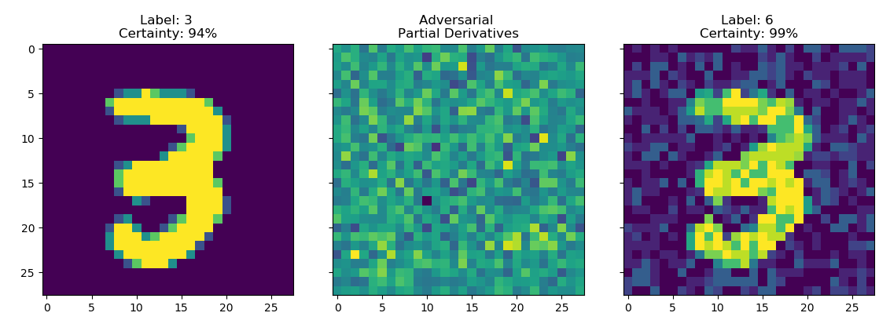
Adversarial images
Some classifications
Applying adversarial gradient

Slide 21
GANs: Generative Adversarial Networks
Goal: generate new images
Generator network
Given noise, tries to output a convincing image
Discriminator network
Tries to tell real and generated images apart
Real data
Discriminator
Noise
Generator

Slide 22
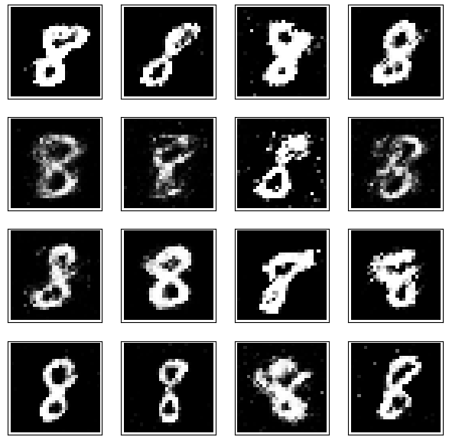
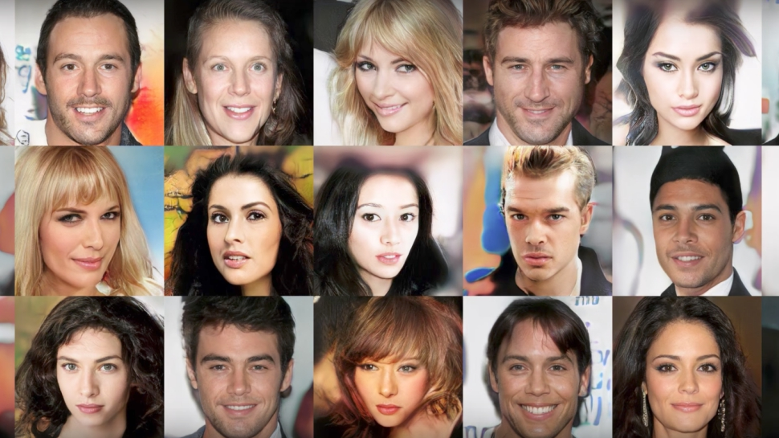
GANs: Generative Adversarial Networks
Generated 8s
Generated faces

Slide 23
Data visualisation
 | Area (m²) | Price (£)
House 1 | 100 | 450,000
House 2 | 60 | 150,000
House 3 | 85 | 350,000
… | … | …

Slide 24
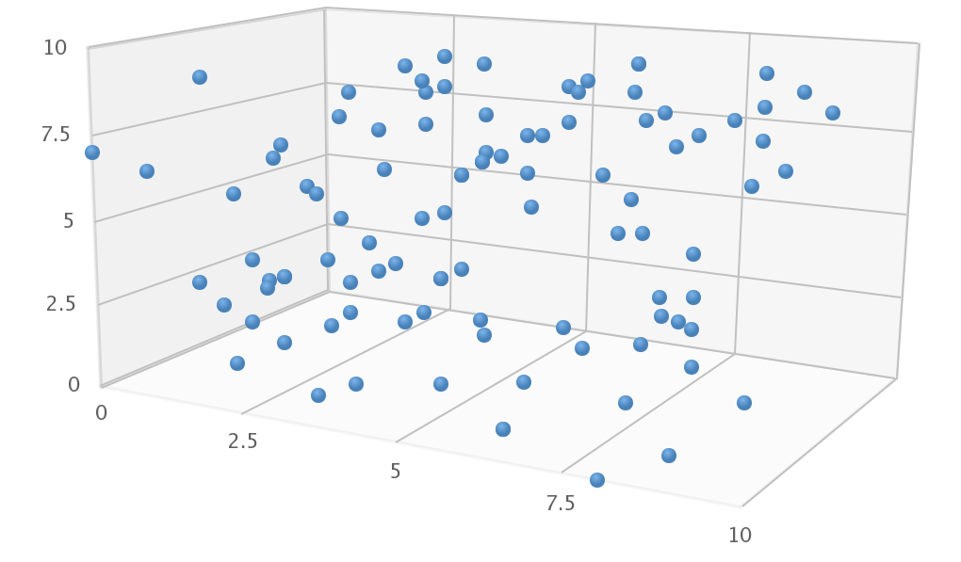
Data visualisation
 | Area (m²) | Price (£) | Distance to town (km)
House 1 | 100 | 450,000 | 20
House 2 | 60 | 150,000 | 0
House 3 | 85 | 350,000 | 4
… | … | … | …
Price (£)
To town (km)
Area (m²)

Slide 25
Data visualisation
 | Area (m²) | Price (£) | Distance to town (km) | Age of house (years)
House 1 | 100 | 450,000 | 20 | 150
House 2 | 60 | 150,000 | 0 | 10
House 3 | 85 | 350,000 | 4 | 35
… | … | … | … | …
???

Slide 26
Dimensionality reduction
High-dimensional data (can’t visualise)
Projected data (lost information, but can visualise)

Slide 27
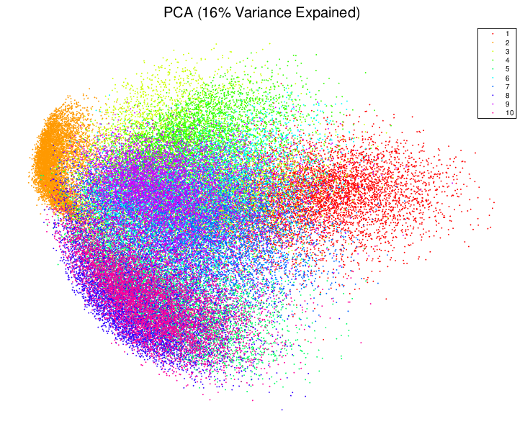
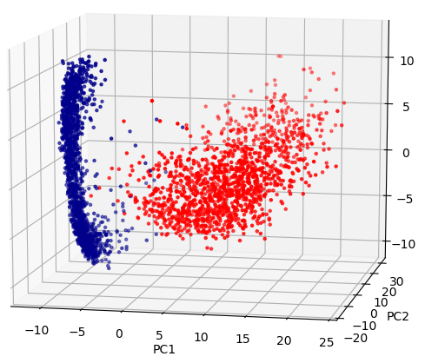
PCA (Principal Component Analysis)
Data matrix X
Variance-covariance matrix XX^{T}
Find eigenvectors with highest eigenvalues
Make an orthogonal basis
Use these directions as axes

Slide 28
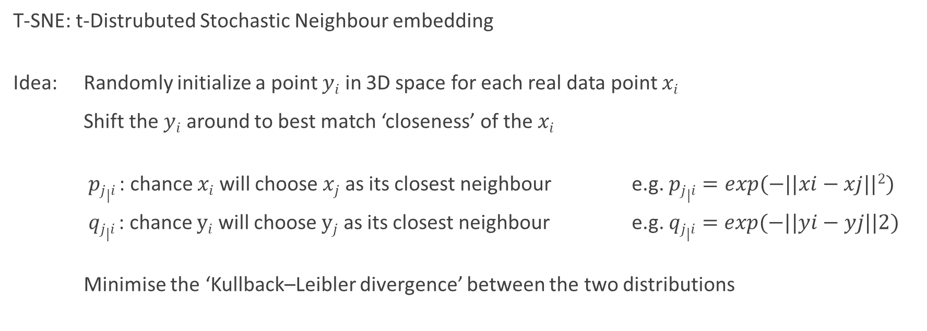
Non-linear projections: T-SNE
T-SNE: t-Distrubuted Stochastic Neighbour embedding
Idea: Randomly initialize a point $yi$ in 3D space for each real data point $xi$
Shift the $yi$ around to best match ‘closeness’ of the $xi$
$pj|i$: chance $xi$ will choose $xj$ as its closest neighbour e.g. $pj|i=exp(−||xi−xj||2)$
$qj|i$: chance $yi$ will choose $yj$ as its closest neighbour e.g. $qj|i=exp(−||yi−yj||2)$
Minimise the ‘Kullback–Leibler divergence’ between the two distributions

Slide 29
Non-linear projections: T-SNE

Slide 30
T-SNE perplexity
Original data: two linked rings in 3D
Low perplexity (local closeness)
High perplexity (global closeness)

Slide 31
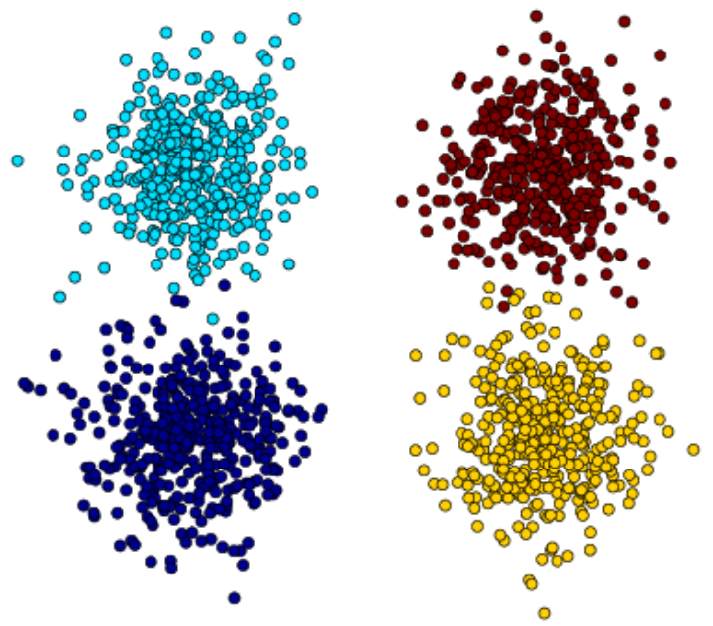
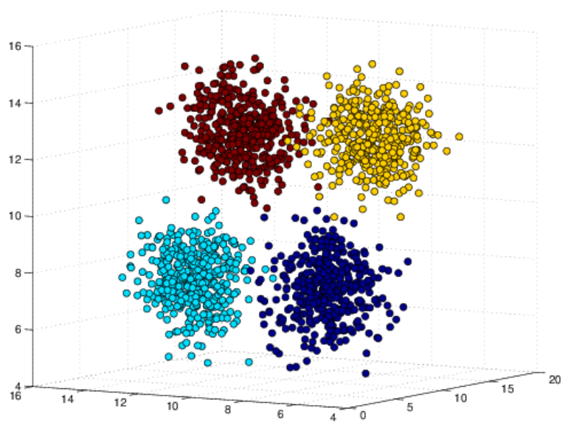
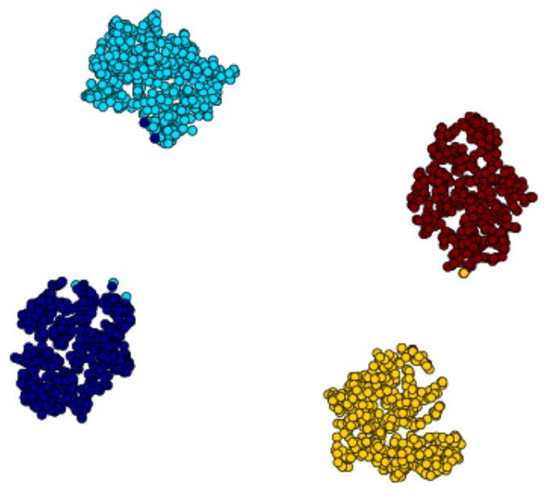
PCA vs TSNE
True data: Gaussian ‘clouds’
PCA projection
T-SNE representation

Slide 32
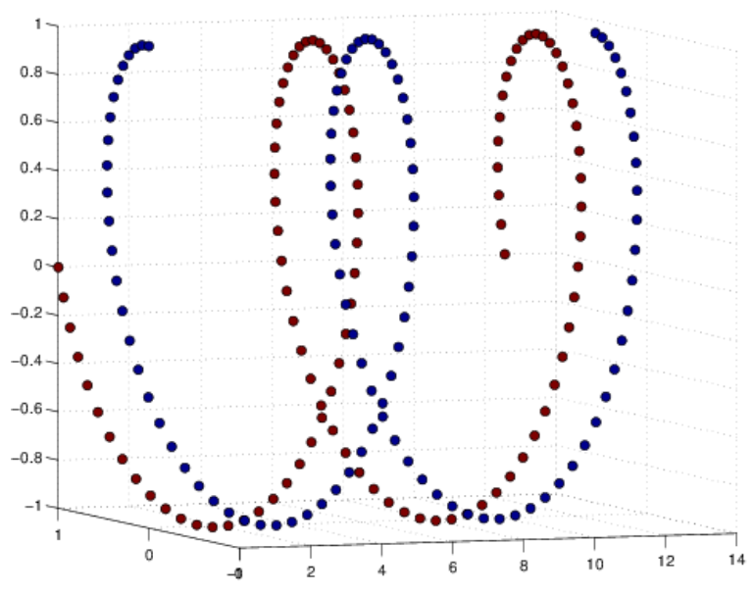
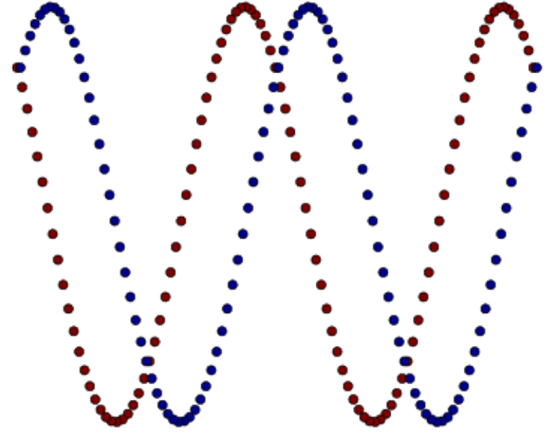
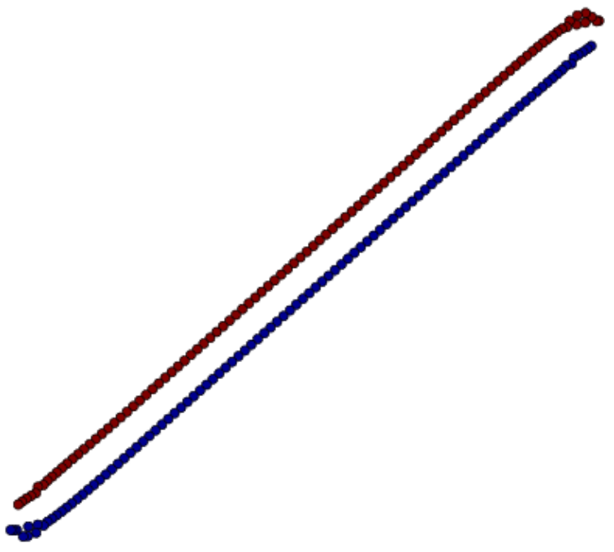
PCA vs TSNE
True data: interlocked spirals
PCA projection
T-SNE representation

Slide 33
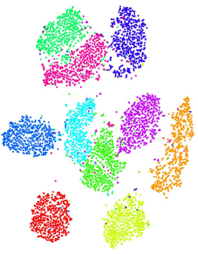
PCA vs TSNE
MNIST PCA projection
MNIST T-SNE representation

Slide 34
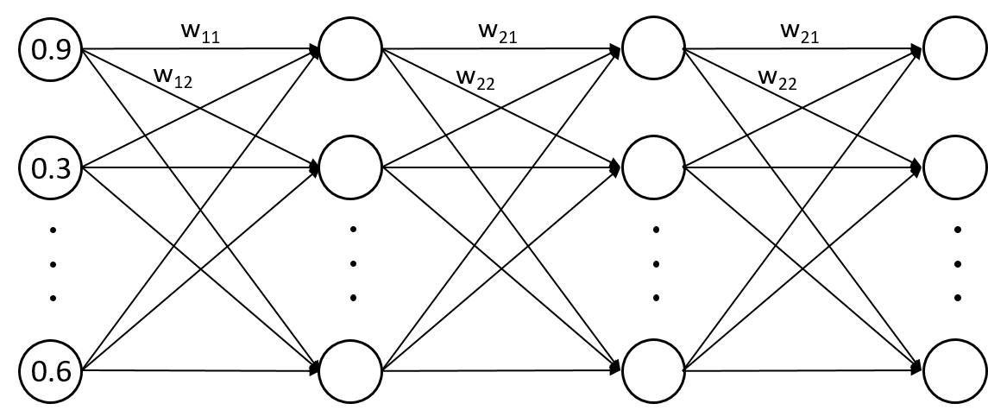


Thanks for listening

